Slide 1


SEC521 Network Security
Dr. Waleed Al-Gobi
DEVELOPING A BEHAVIORAL ANALYSIS FRAMEWORK FOR THE DETECTION AND MITIGATION OF RANSOMWARE ATTACKS
Presentation by Kaniz Fatima Daya

Slide 2

TABLE OF CONTENTS
  Introduction
  Related Work
  My approach
  Methodology
  Result
  Conclusion
  References

Slide 3

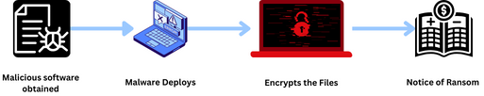
INTRODUCTION
Ransomware is a type of malicious software that encrypts a victim's files, making them inaccessible until a ransom is paid, usually in cryptocurrency. It commonly enters through phishing emails or network vulnerabilities. Victims are pressured to pay to regain access to their data, though payment doesn’t guarantee decryption. This cybercrime affects individuals, businesses, and governments, leading to financial loss, operational disruption, and reputational damage.

Slide 4
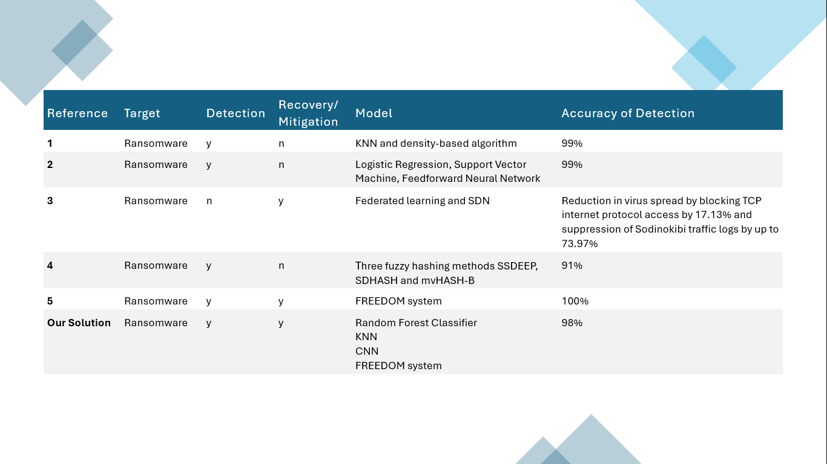
RELATED WORK

Slide 5
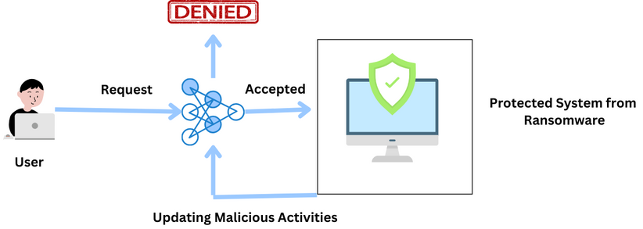
MY APPROACH

Slide 6
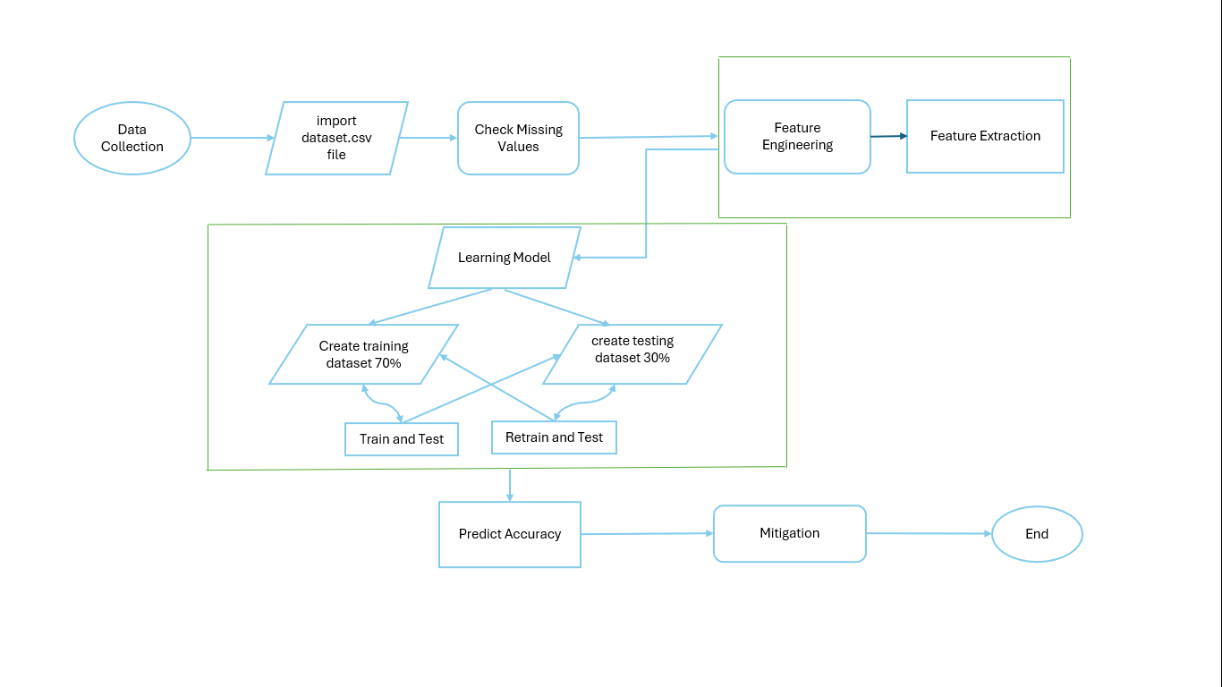
METHODOLOGY

Slide 7
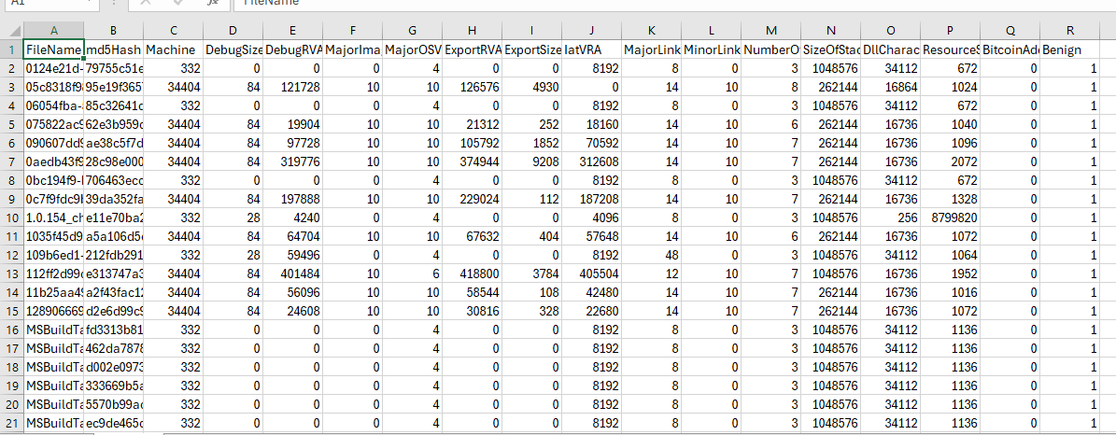
METHODOLOGY
THE DATASET

Slide 8
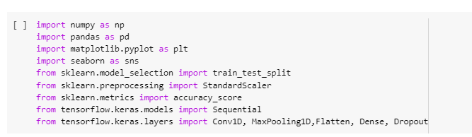
METHODOLOGY
The tools used:
  Python
  Google CoLab
The Library used in Python:

Slide 9
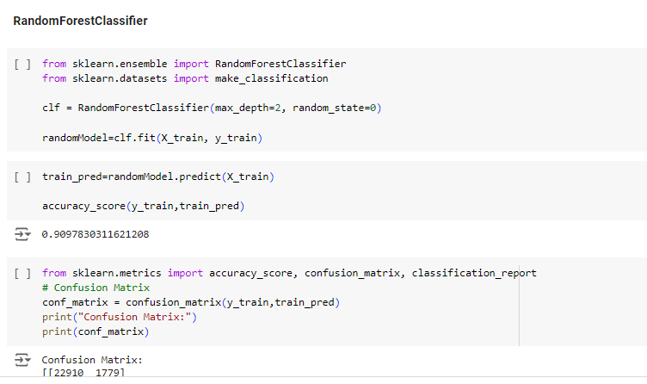
TRAINING & TESTING MODEL

Slide 10
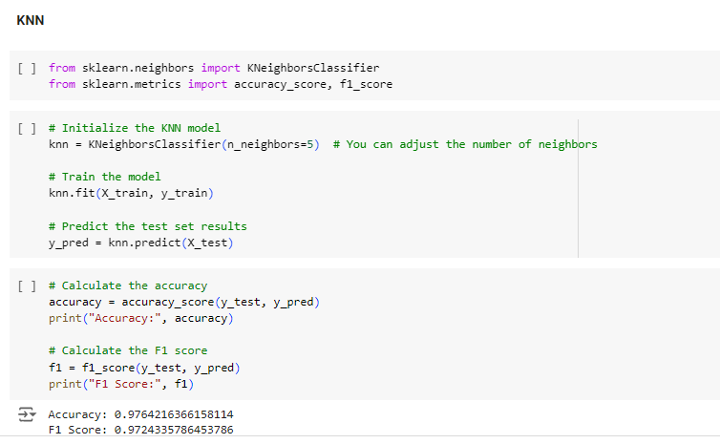
TRAINING & TESTING MODEL

Slide 11
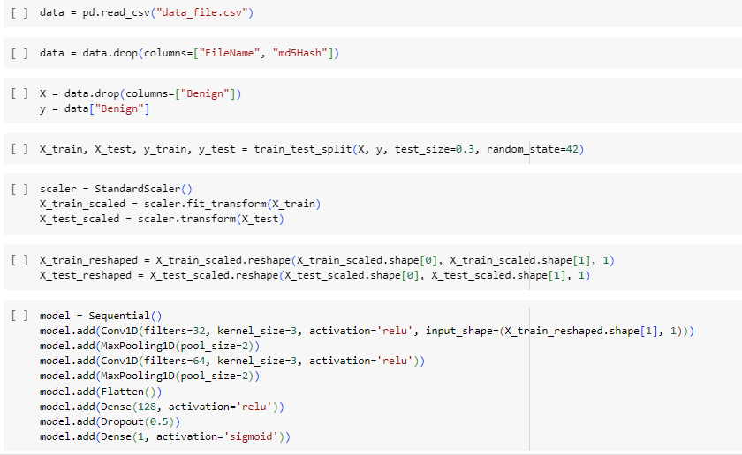
TRAINING & TESTING MODEL

Slide 12
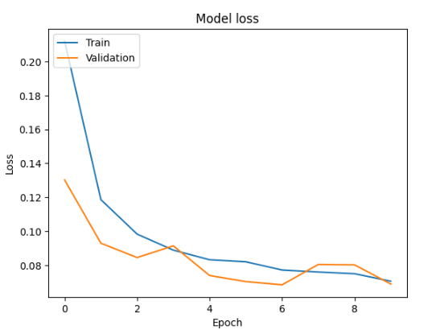
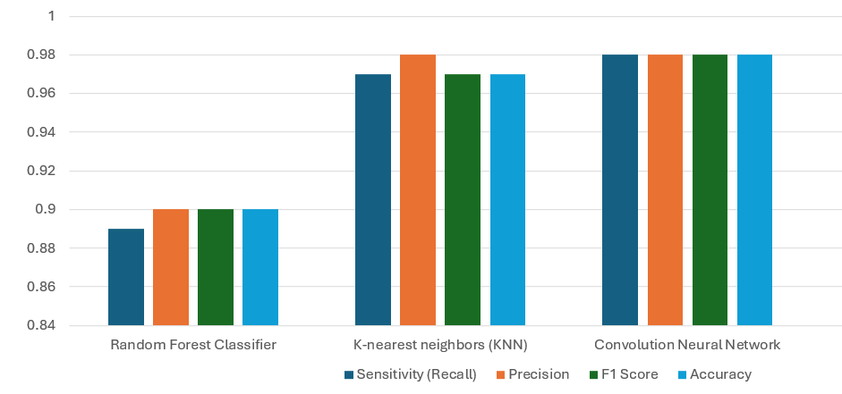
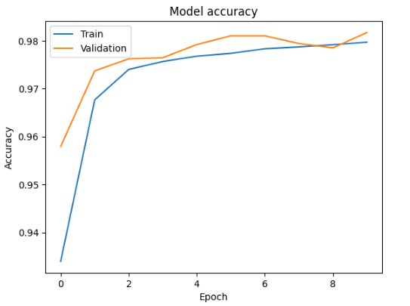
RESULT

Slide 13
CONCLUSION
This study used machine learning and deep learning to suggest an effective way to identify and mitigate ransomware utilizing the FREEDOM system [5]. The three Machine Deep Learning algorithms Random Forest Classifier, KNN, and CNN were used in this detection approach to assess the success rate of each method's similarity identification on the gathered ransomware assault. For this specific ransomware attack, all three detection techniques yielded extremely high similarity detection findings (over 89%). The algorithm's accuracy is 90%, 97%, and 98%, in that order.In comparison to the other two Random Forest Classifier and KNN, the CNN yielded comparatively superior outcomes.This suggested CNN is a quick and effective way to identify the attack.

Slide 14
REFERENCES
[1] Jian Du, Sajid Hussain Raza, Mudassar Ahmad , Iqbal Alam , Saadat Hanif Dar, and Muhammad Asif Habib. Digital Forensics as Advanced Ransomware Pre-Attack Detection Algorithm for Endpoint Data Protection. Security and Communication Networks,Vol. 2022. Availability: https://dl.acm.org/doi/abs/10.1155/2022/1424638
[2] Chandra Thapa1(B), Kallol Krishna Karmakar2, Alberto Huertas Celdran3,Seyit Camtepe1, Vijay Varadharajan2, and Surya Nepal1,4.FedDICE: A Ransomware Spread Detection in a Distributed Integrated Clinical Environment Using Federated Learning and SDN Based Mitigation.Quality, Reliability, Security and Robustness in Heterogeneous Systems Conference paper. Availability: https://link.springer.com/chapter/10.1007/978-3-030-91424-0_1
[3] Rusydi Umar1, Imam Riadi2, Ridho Surya Kusuma. Mitigating Sodinokibi Ransomware Attack on Cloud Network Using Software-DefinedNetworking (SDN). International Journal of Safety and Security Engineering. https://www.iieta.org/journals/ijsse/paper/10.18280/ijsse.110304
[4] Nitin Naik, Paul Jenkins1 and Nick Savage. A Ransomware Detection Method Using Fuzzy Hashing for Mitigating the Risk of Occlusion of Information Systems. IEEE International Symposium on Systems Engineering (ISSE). Availability: https://ieeexplore.ieee.org/document/8984540
[5] Joshua Morris1, Dan Lin1, and Marcellus Smith2. Fight Virus Like a Virus: A New Defense Method Against File-Encrypting Ransomware. Journal of ResearchGate. Avaibility: https://www.researchgate.net/publication/350311509_Fight_Virus_Like_a_Virus_A_New_Defense_Method_Against_File-Encrypting_Ransomware/references

Slide 15
APPENDIX
The deep learning and machine learning code:
https://colab.research.google.com/drive/1cc5QfY_e1QvkR55P89Xi4nUYstxgh_mT?usp=sharing
The Dataset:
https://www.kaggle.com/datasets/amdj3dax/ransomware-detection-data-set .

Slide 16
THANK YOU

